Slide 1
Thursday, January 31, 2013
Agenda:
TISK, No MM
HW Check
Lesson 12-6: Exponential Functions part 1
Homework: Ch 12 HW Packet #2, §12-6 problems (We will also work on these problems tomorrow.)
TISK Problems
Write an equation in slope-intercept form for a line that passes through the points (-2, 1) and (4, 7).
Miss Wiltjer places the names of 28 students in a hat. Twelve of the names are girls and the rest are boys. Find the probability of choosing a boys’ name then a girls’ name if she doesn’t replace the first name drawn.
Write and solve a proportion: Eighteen is what percent of 40?

Slide 2
Ch12 Quiz 1 Stats
7D
Class Average: 81.5%
Class Median: 83.8%
High Score: 100%
Low Score: 31%
7B
Class Average: 83.4%
Class Median: 88.1%
High Score: 100%
Low Score: 49%
7C
Class Average: 80.2%
Class Median: 84.2%
High Score: 100%
Low Score: 41%

Slide 3
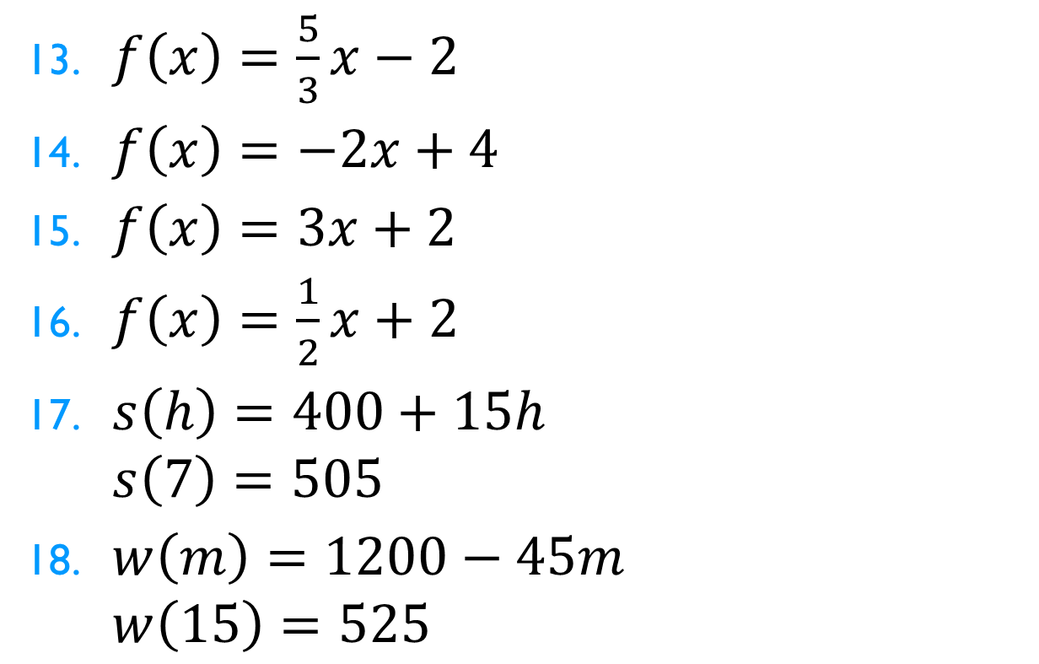
Homework Check
$f\left(x\right)=\frac{5}{3}x−2$
$f\left(x\right)=−2x+4$
$f\left(x\right)=3x+2$
$f\left(x\right)=\frac{1}{2}x+2$
$s\left(h\right)=400+15h$ $s\left(7\right)=505$
$w\left(m\right)=1200−45m$ $w\left(15\right)=525$

Slide 4
§12-6 Exponential Functions
Another type of function is called an exponential function.
Exponential functions either get really big, really fast or they get really small, really fast
How can you tell if a function is exponential?
Look at its graph.
Look at its equation.

Slide 5
§12-6 Exponential Functions
Equations that are exponential use the following rule:
$f\left(x\right)=p∙a^{x}$
x has to be in the exponent!
$a$ and $p$ are numbers and
a is greater than 0 (and not equal to 1)

Slide 6
§12-6 Exponential Functions
Exponential functions can look like one of the following graphs:

Slide 7
§12-6 Exponential Functions
Exponential functions can look like one of the following graphs:

Slide 8
§12-6 Exponential Functions
Exponential functions can look like one of the following graphs:

Slide 9
§12-6 Exponential Functions
Exponential functions can look like one of the following graphs:

Slide 10
§12-6 Exponential Functions
So how can you tell which one of the graphs it is?
Make a table of values and graph it!
(We’ll do these on the board together.)
$$f\left(x\right)=2∙3^{x}$$

Slide 11
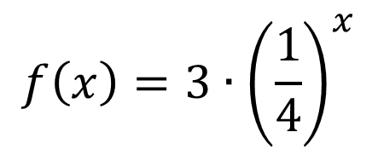
§12-6 Exponential Functions
So how can you tell which one of the graphs it is?
Make a table of values and graph it!
(We’ll do these on the board together.)
$$f\left(x\right)=3∙{\left(\frac{1}{4}\right)}^{x}$$

Slide 12
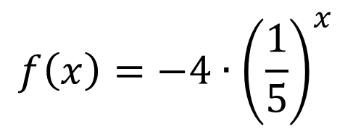
§12-6 Exponential Functions
So how can you tell which one of the graphs it is?
Make a table of values and graph it!
(We’ll do these on the board together.)
$$f\left(x\right)=−4∙{\left(\frac{1}{5}\right)}^{x}$$

Slide 13
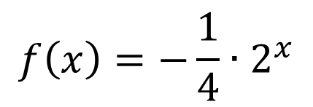
§12-6 Exponential Functions
So how can you tell which one of the graphs it is?
Make a table of values and graph it!
(We’ll do these on the board together.)
$$f\left(x\right)=−\frac{1}{4}∙2^{x}$$

